Slide 1

Could we deal with the lack of training data in AI-based haemodynamic MRI acceleration?
Fast haemodynamic MRI reconstruction by deep learning
Sahar Yousefi
Radiology department
Notes:
Today I am gonna tell you about AI-based hemodynamic mri acceleration and whether or not we can deal with lack of training data for this goal

Slide 2
Motivation: why haemodynamic MRI is important?
Neurovascular disease is not just evidenced by loss of anatomical integrity
Ischemic lesions
Stenosis/occluded vessels
Arteriovenous Vascular Malformations
Aneurysms
Atherosclerotic plaques
Tumours
It involves the vessels and alterations in physiology
Blood velocity
Cerebral blood flow
Arterial blood volume
Arterial arrival time
Before anatomical consequences are visible
Slide from: L. Václavů, Clinical relevance of ASL, Haemodynamic measurements in cerebrovascular diseases
Notes:
First some introduction. Why we are interested in hemodynamic MRI? neurovascular diseases are not just evidenced by the loss of anatomical integrity such as lesions, vascular occlusions and vasculopathy, but they involve the vessels themselves, as well alterations in physiology. This can include the blood velocity, or cerebral blood flow changes, or changes in arterial blood volume and even the time it takes the blood to arrive can be an early indicator of a cerebrovascular disease.
If we measure these parameters by using haemodynamic MRI, we can learn about the progression of diseased brain tissue, often before the anatomical consequences are visible.

Slide 3
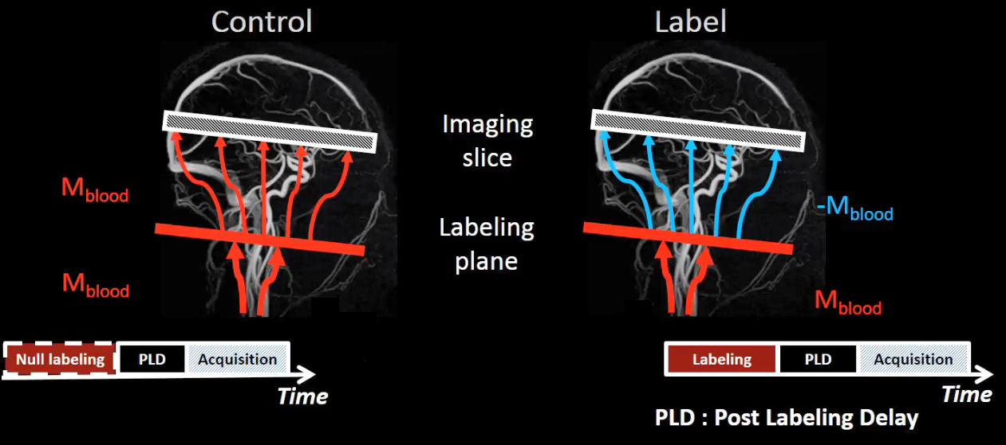
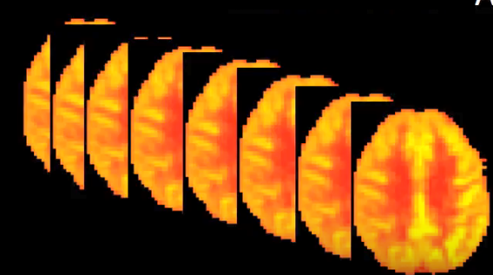
Arterial spin labeling (ASL)
A non-invasive MRI technique for quantitative assessment of haemodynamic measurment
Uses blood water as an endogenous tracer
ASL intrinsically has low SNR, so the average of ASL difference images is used for quantification
Control – Label = ASL difference image
Multiple acquisitions increase ASL SNR
Figures from: Z. Shirzadi et al., Enhancement of automated blood flow estimates (ENABLE) from arterial spin‐labeled MRI, Journal of Magnetic Resonance Imaging, 2018
Notes:
Arterial spin labelling is the only non-invasive imaging technique that can be use to assess multiple parameters relating to cerebral physiology in the whole brain.
ASL uses arterial blood water as an endogenous tracer for cerebral blood flow quantification
For this purpose the magnetization of the blood molecules is labeled by inversion pulses in the neck. After a time delay a label image is acquired, this time delay is called PLD and allows the labeled blood to reach to the tissue voxel.
*****
Since the label image contains both blood signal and tissue signal a control image is also acquired to suppress the tissue signal.
*****
So the difference between control and label images gives us an ASL difference image

Slide 4
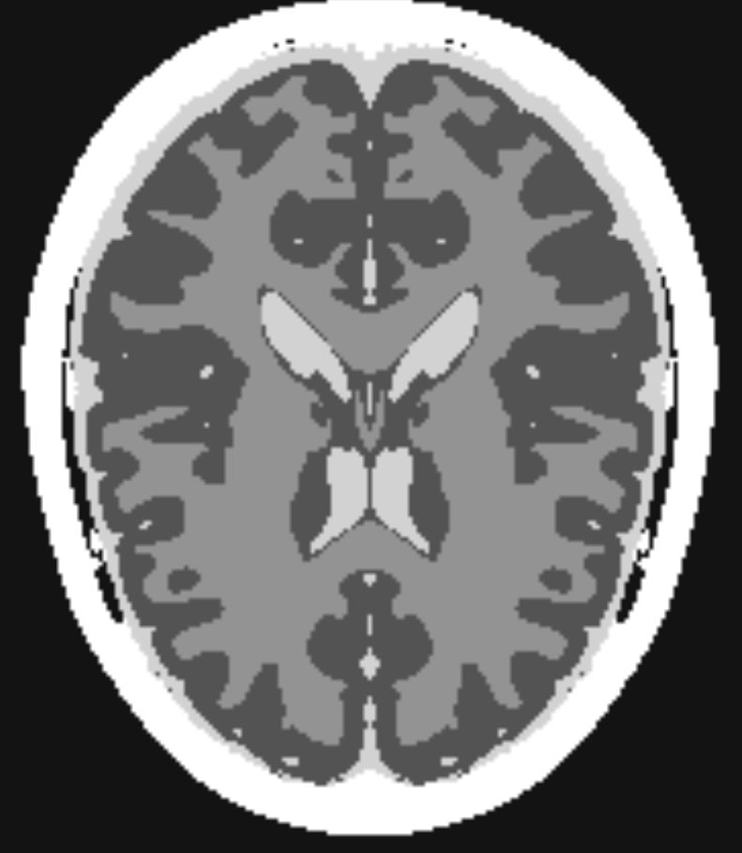
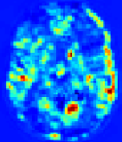
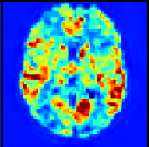
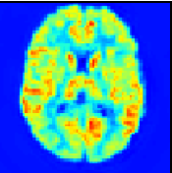
Hadamard time-encoded ASL (te-ASL)
Has been proposed for highly SNR- and time-efficient multiple-PLD ASL imaging
Encoding slightly different information content into each repetition, instead of repeating the same sequence over-and over again
Divide the preparation module into (H-1) blocks
Label or control for each block is determined according to the Hadamard matrix
Using Hadamard time decoding, the contribution of each sub-bolus can be isolated resulting in 4D perfusion scans
Hadamard matrix of rank 4
Time
-1
-1
-1
Img# 1
1
-1
1
Img# 2
-1
1
1
Img# 3
1
1
-1
Img# 4
Decoding
Perfusion scans
Label
Control
Notes:
Hadamard te ASL is a time and snr efficient approach which encodes the temporal information according to a Hadamard matrix of rank h, for this goal each module is divided into h-1 sub-boluses.
label and controls for each bolus is defined by the Hadamard matrix

Slide 5
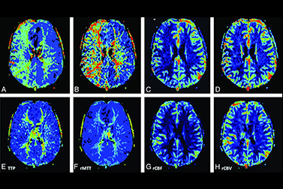
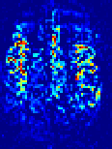
Dynamic perfusion and angiography reconstruction from Hadamard te-ASL
Using Hadamard te-ASL both with and without flow-crushing, the 4D perfusion and angiographic scans can be reconstructed→ two acquisitions
We proposed a 3D convolutional neural network (CNN) to accelerate Hadamard te-ASL quantification 2X faster
Crushed Hadamard te-ASL
Non-crushed Hadamard te-ASL
-1
-1
-1
Img# 1
-1
-1
-1
Img# 1
1
-1
1
Img# 2
1
-1
1
Img# 2
-1
1
1
Img# 3
-1
1
1
Img# 3
1
1
-1
Img# 4
1
1
-1
Img# 4
Decoding
Decoding
Perfusion
Perfusion + Angiography
-
Control crushed
Label crushed
Angiography
Control non-crushed
Label non-crushed
Notes:
If we use hadamard te-asl both with and without flow crushing, which in flow crushed the vascular signal is suppressed, 4D perfusion and angiography images can be reconstructed

Slide 6
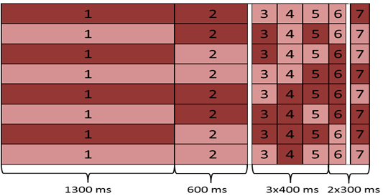
Goal: Accelerating perfusion and angiography reconstruction 2X faster
Non-crushed Hadamard te-ASL
Time points
Perfusion
2X faster acquisition
CNN
=Static tissue + Perfusion + Angiography
Vascular crushed Hadamard te-ASL
Angiography
CNN:
No. of inputs: 8
No. of outputs: 14
=Static tissue + Perfusion
Notes:
*****
For this goal we used Hadamard matrix of rank 8.
instead of using the complete acquisitions, we used an interleaved half-sampled of crushed and non-crushed Hadamard te-ASL scans as the input of the network. And the outputs of the network are perfusion and angiography scans each at 7 time points

Slide 7
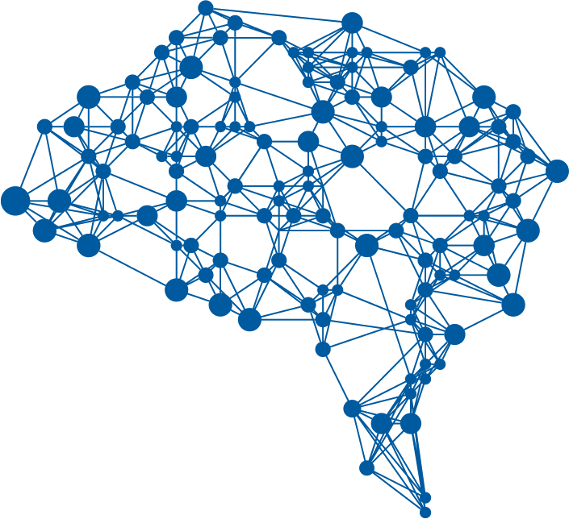
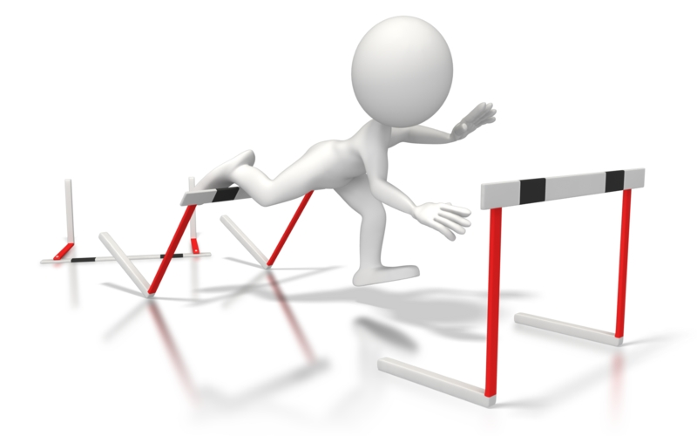
Challenges
Training a CNN needs a lot of data
Needs too many volunteers & Acquiring ASL data is time consuming
Are volunteers representative for also patient population?
AI
Notes:
For training a dnn we need a huge dataset, which needs lots of volunteers and subsequently lots of time.
Also the data should be representative for patient population

Slide 8
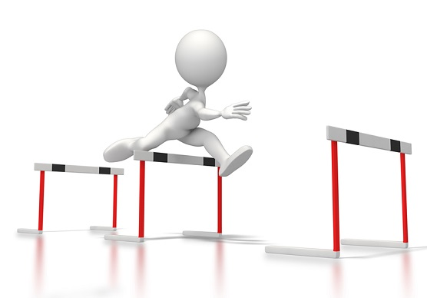
Dataset
Solution: simulated ASL data for training and validation sets
AI
Notes:
In this study we started by the normal subjects and since it is difficult to acquire substantial amounts of real data, we proposed to model the input data, which allows to generate a sufficient amount of training data.

Slide 9
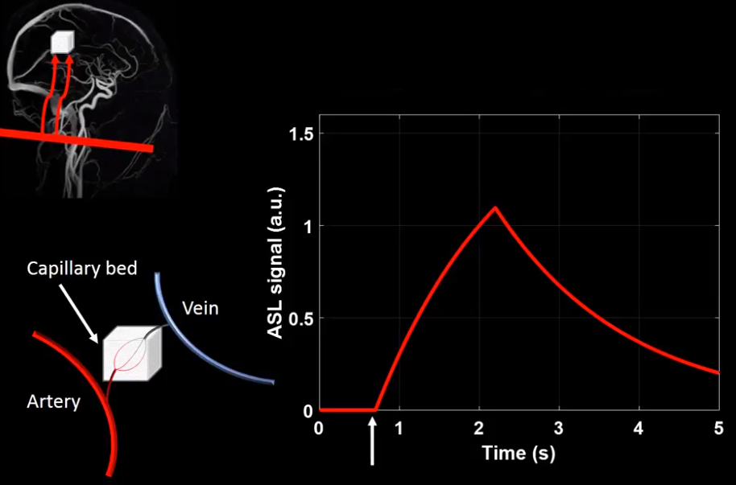
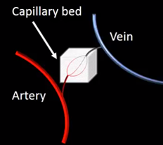

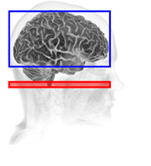
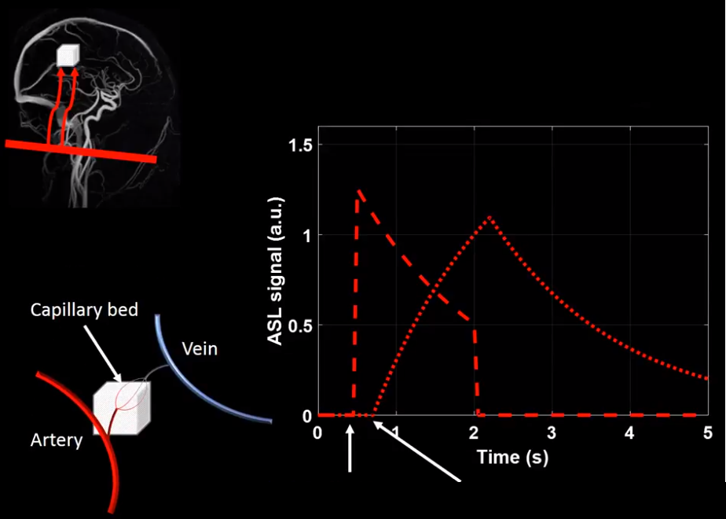
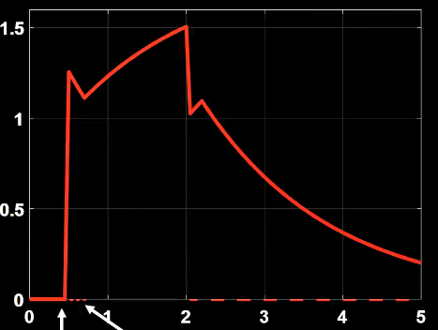
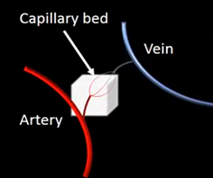
Kinetic model for ASL signal (Buxton curve)
Standard ASL
Hadamard te-ASL
Scan plane
Label plane
Arterial transit time (ATT): travel time of labeled blood to each voxel
A block of labels
Multiple sub-boluses
LATT:Large arterial transit time
ATT
Notes:
As I mentioned earlier, in the standard ASL we have a block of label and this plot shows how the asl signal in a tissue voxel looks like
But if the voxel contains a part of a large artery we have two components: tissue component and arterial component
If we sum these two components together, this is how the signal looks like
However in the Hadamard te-asl approach we have multiple sub-boluses at different time points and we can not use the same kinetic model here. Hence we generalized the kinetic model of the standard asl and

Slide 10
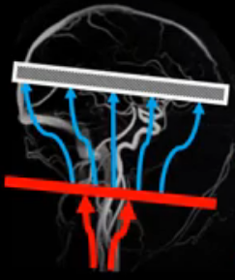
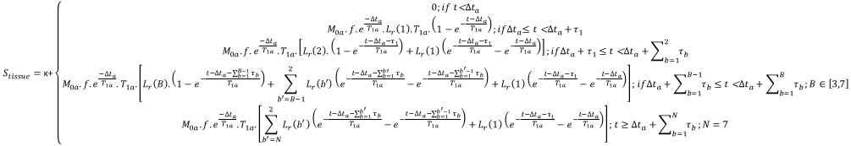
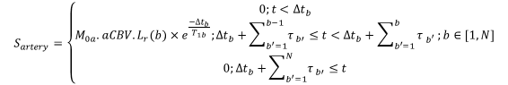
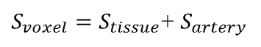
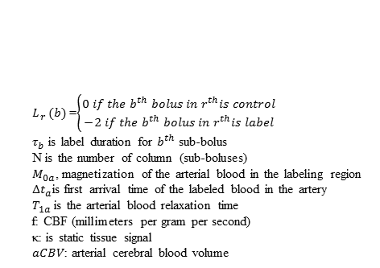
Kinetic model for Hadamard time encoded PCASL signal
Imaging slice
-M_{blood}
Labeling plane
M_{blood}
$L_{r}$ $(b)$=$\left\{\begin{aligned}0 if the b^{th} bolus in{ r}^{th}is control \\ −2 if the b^{th} bolus in{ r}^{th}is label\end{aligned}\right.$
$τ_{b}$ is label duration for $b^{th}$ sub-bolus
N is the number of column (sub-boluses)
$M_{0a}$, magnetization of the arterial blood in the labeling region
${∆t}_{a}$is first arrival time of the labeled blood in the artery
$T_{1a}$ is the arterial blood relaxation time
f: CBF (millimeters per gram per second)
κ: is static tissue signal
$aCBV$: arterial cerebral blood volume
$S_{voxel}=S_{tissue}$+ $S_{artery}$
Notes:
…, we ended up these equations for tissue voxels and arterial voxels
The ASL signal can be calculated by summing these compartments together.

Slide 11
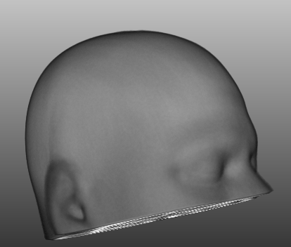
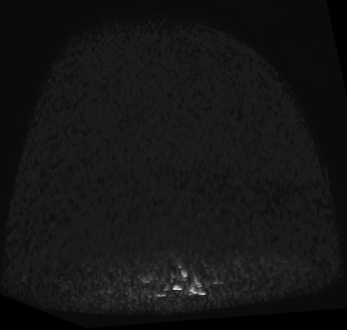
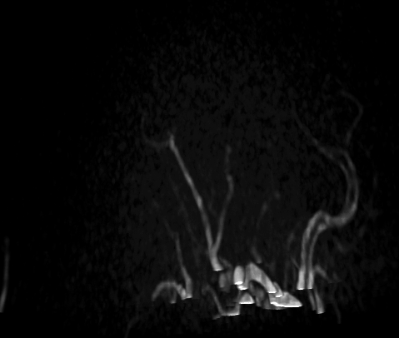
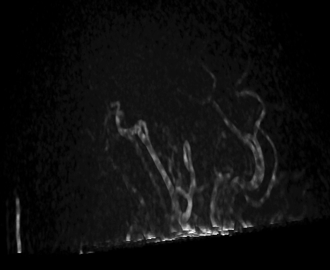
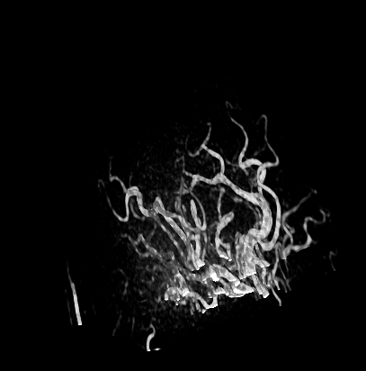
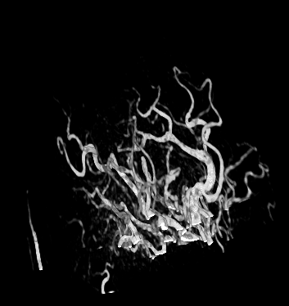
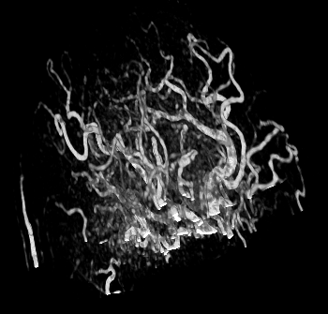
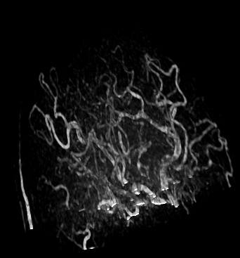
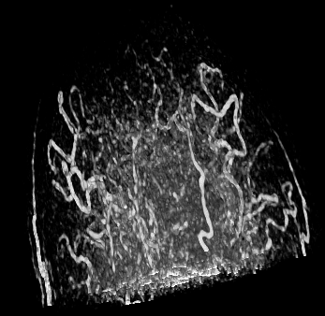
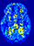
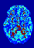
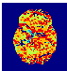
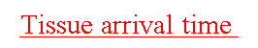

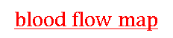
Generating te-pCASL data:
$$\text{Arterial} \text{arrival} \text{time}$$
$$\text{Tissue} \text{arrival} \text{time}$$
$$\text{blood} \text{flow} \text{map}$$
High temporal resolution in vivo te-crushed pCASL data
$$S_{voxel}\text{=}φ\left(\text{Arterial} \text{arrival} \text{time}\text{ , }\text{Tissue} \text{arrival} \text{time} ,\text{blo}od flow map\right)$$
Moving image
BrainWeb dataset
BrainWeb segmentation
In vivo cinema data (denotes 4D angiography)
Fixed image
moving image
Control
Label
-
-
-
-
-
-
-
-
f map
Deformed te-crushed pCASL data
Arterial arrival time
Kinetic arterial model
Kinetic tissue model
Arterial te-pCASL signal
+
tissue arrival time
Tissue te-pCASL signal
te-pCASL signal
Notes:
so the ASL signal is a function of arterial arrival time, tissue arrival time and blood flow *****
In this framework, for extracting aat we acquired a cinema data (from a healthy subject) which by subtracting control scans from the label scans, the angiography maps for 8 different phases were obtained. Then for each voxel we get the arterial arrival time. By applying a transformation algorithm we will be able to augment the att map.
*****
The second parameter of the kinetic function is tissue arrival time, for obtaining this variable we acquired a crushed te-asl data from another subject. Then by using elastix, we registered the cinema data with the crushed te-asl. Afteward, by using the timing plan of the crushed te-asl, the tissue arrival time map was obtained. Here also, we can use a transformation algorithm in order to augment the tissue arrival time.
*****
the third parameter of the kinetic function is the blood flow map. As this value is different for different tissue types in terms of GM,WM and CSF, we registered the cinema data with a mni-atlas to extract the segmentation of the different tissues. Similar to the previous parameters, after computing the f-map a deformation algorithm is used for augmentation.
*****
Now by using the kinetic function which was explained in the last slide, we will be able to compute the arterial te-asl signal and tissue te-asl signal. Finally by adding these values together we will have the te-asl signal for each voxel.

Slide 12
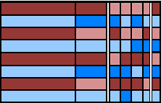
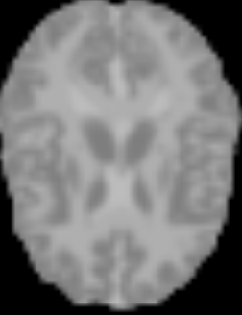
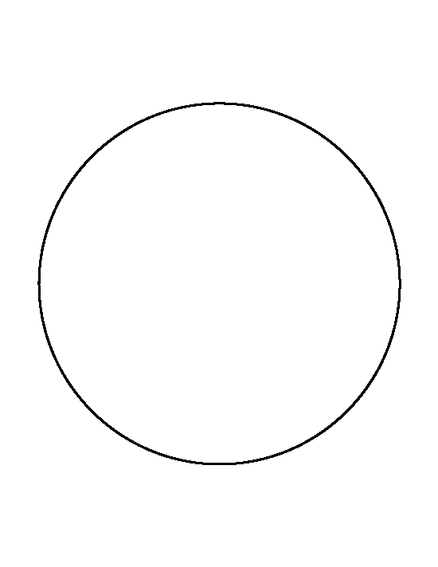
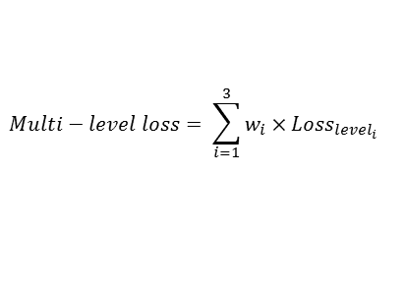
Proposed network
Input
Early fusion
Dense-Unet
Multi-level loss function
Interleaved Hadamard te-pCASL
103³
53³
39³×14
target
53³×8
51³×8
39³×40
39³×28
39³×14
39³×14
Patch extraction
Loss _{level1}
c
25³×8
23³×16
9³×24
19³×32
39³×14
Loss _{level2}
Scans
1300ms
600ms
3×400ms
2×300ms
11³×16
9³×24
39³×14
Loss _{level3}
c
$$Multi−level loss= \sum_{i=1}^{3}{w_{i}×{Loss}_{{level}_{i}}}$$
Control crushed
Label crushed
Dense block:
Improve the flow of information and gradients throughout the network
Leads to feature re-usability and have a compact model
Dense-block
Control non-crushed
Conv 1×1×1 + BN + Leaky ReLu
Conv 3×3×3 + BN + Leaky ReLu
Label non-crushed
Downsample
Upsample
c
Concatenation
12
Reconstruction of Dynamic Perfusion and Angiography by CNN, S.Yousefi et al.
Loss function
Notes:
So the input of the network is an interleaved half sampled Hadamard te crushed and non-crushed asl. After patch extraction and early fusion we feed the result into a Unet shape network. In which the green blocks indicate dense blocks with loop connectivity patterns. At the end we compute the loss function based on the loss function of each level.

Slide 13
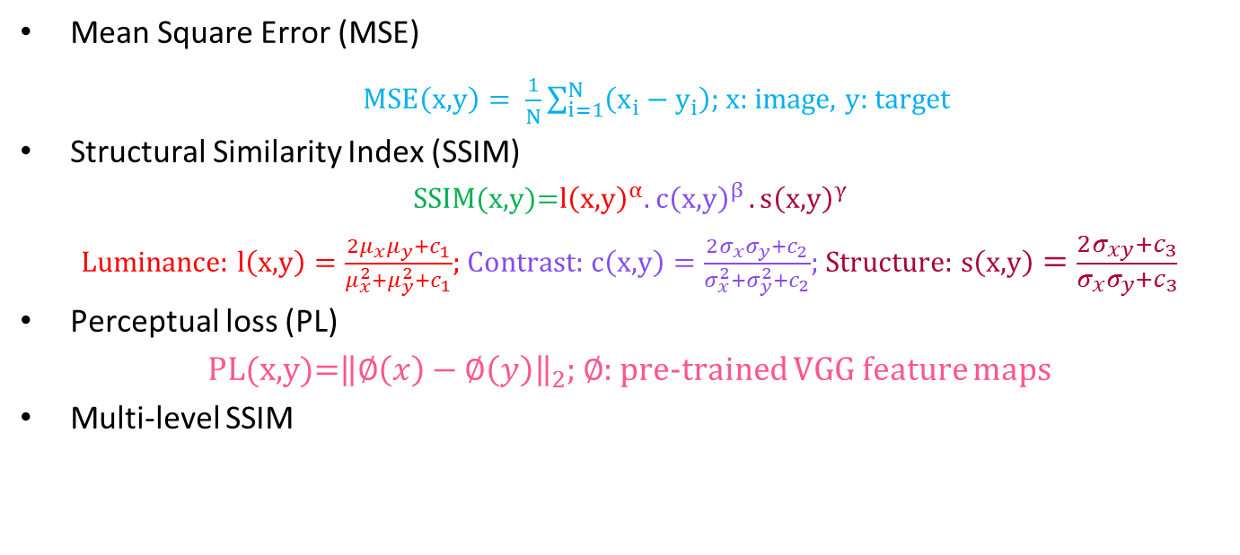
Loss functions
Mean Square Error (MSE)
$MSE\left(\text{x}\text{,}y\right)= \frac{1}{N}\sum_{i=1}^{N}{\left(x_{i}−y_{i}\right)}$; x: image, y: target
Structural Similarity Index (SSIM)
$$SSIM\text{(}\text{x}\text{,}\text{y}\text{)=}{\text{l}\left(\text{x}\text{,}\text{y}\right)}^{α}{.c\left(\text{x}\text{,}\text{y}\right)}^{β}{.s\left(\text{x}\text{,}\text{y}\right)}^{γ}$$
Luminance: $\text{l}\left(\text{x}\text{,}\text{y}\right)=\frac{2μ_{x}μ_{y}+c_{1}}{μ_{x}^{2}+μ_{y}^{2}+c_{1}}$; Contrast: $c\left(\text{x}\text{,}\text{y}\right)=\frac{2σ_{x}σ_{y}+c_{2}}{σ_{x}^{2}+σ_{y}^{2}+c_{2}}$; Structure: $s\left(\text{x}\text{,}\text{y}\right)=\frac{2σ_{xy}+c_{3}}{σ_{x}σ_{y}+c_{3}}$
Perceptual loss (PL)
$\text{PL}\text{(}\text{x}\text{,}\text{y}\text{)=}{\left\|∅\left(x\right)−∅\left(y\right)\right\|}_{2}$; $∅$: pre-trained VGG feature maps
Multi-level SSIM
Notes:
We compared the performance of different loss functions contain: MSE, SSIM which considers luminance, contrast and structure similarities. Perceptual loss with a pre-trained VGG net. And multi-level SSIM

Slide 14
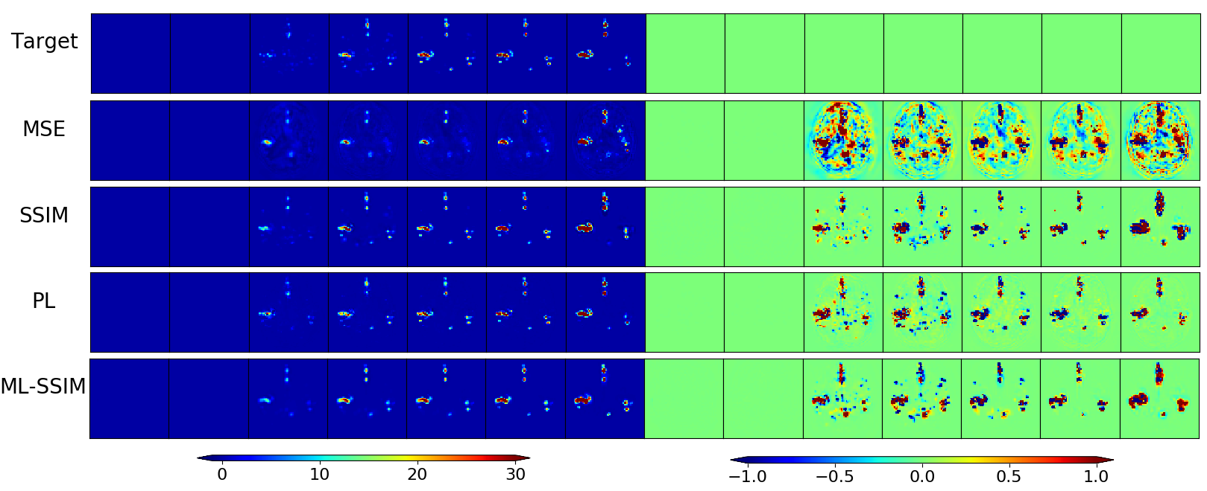
Qualitative results for dynamic angiography reconstruction
Results at multiple PLDs (ms)
Error at multiple PLDs (ms)
265
565
865
1265
1665
5065
2665
265
565
865
1265
1665
5065
2665
Notes:
Here also you can see a qualitative comparison between different loss functions for dynamic angiography reconstruction

Slide 15
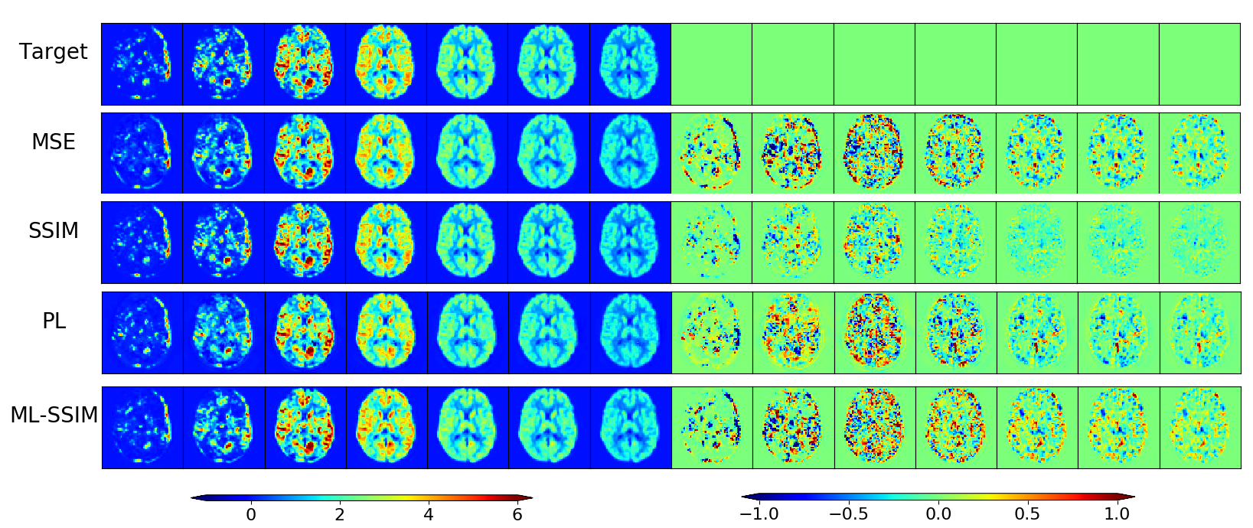
Qualitative results for dynamic perfusion reconstruction
Results at multiple PLDs (ms)
Error at multiple PLDs (ms)
265
565
865
1265
1665
5065
2665
265
565
865
1265
1665
5065
2665
Notes:
Here you can see a qualitative comparison between different loss functions for dynamic perfusion reconstruction

Slide 16
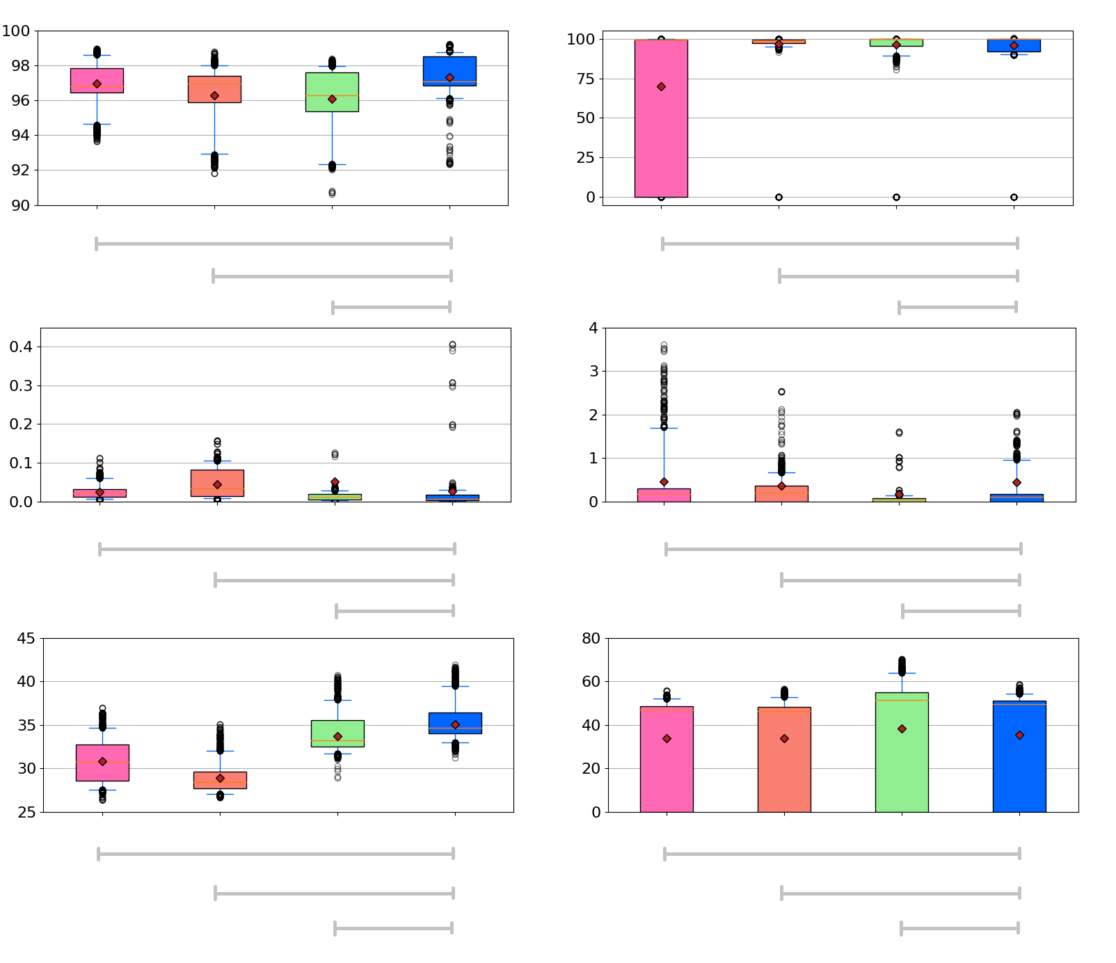
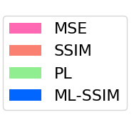
Quantitative results
Perfusion
Angiography
SSIM%
*p-value<0.01
*p-value<0.01
*p-value<0.01
p-value=1.7
*p-value<0.01
*p-value<0.01
MSE
*p-value<0.01
*p-value<0.01
*p-value<0.01
*p-value<0.01
*p-value<0.01
*p-value<0.01
Statistically significant test was done by Wilcoxon signed-rank test
PSNR
*p-value<0.01
*p-value<0.01
*p-value<0.01
*p-value<0.01
*p-value<0.01
*p-value<0.01
* Statistically significant difference
Notes:
This box plots show a quantitative comparison between the mentioned loss functions for different metrics. As you can see the ML-SSIM and SSIM worked better in perfusion and angiography reconstruction respectively

Slide 17
Conclusion
The proposed network obtained promising results for the challenging problem of 4D angiography and perfusion reconstruction
This makes perfusion and angiography reconstruction 2X faster
Reconstruction of 4D perfusion and angiography scans takes 205 ± 232 (ms) from the interleaved 50%-sampled crushed & non-crushed data of size 107³
Would you like to know more?
“Fast Dynamic Perfusion and Angiography Reconstruction using an end-to-end 3D Convolutional Neural Network”
S.Yousefi et al., Machine Learning for Medical Image Reconstruction 2019
Notes:
To conclude we obtained promising results for accelerated perfusion and angiography reconstruction
The next step of this study is training and validation of the network for in vivo data

Slide 18
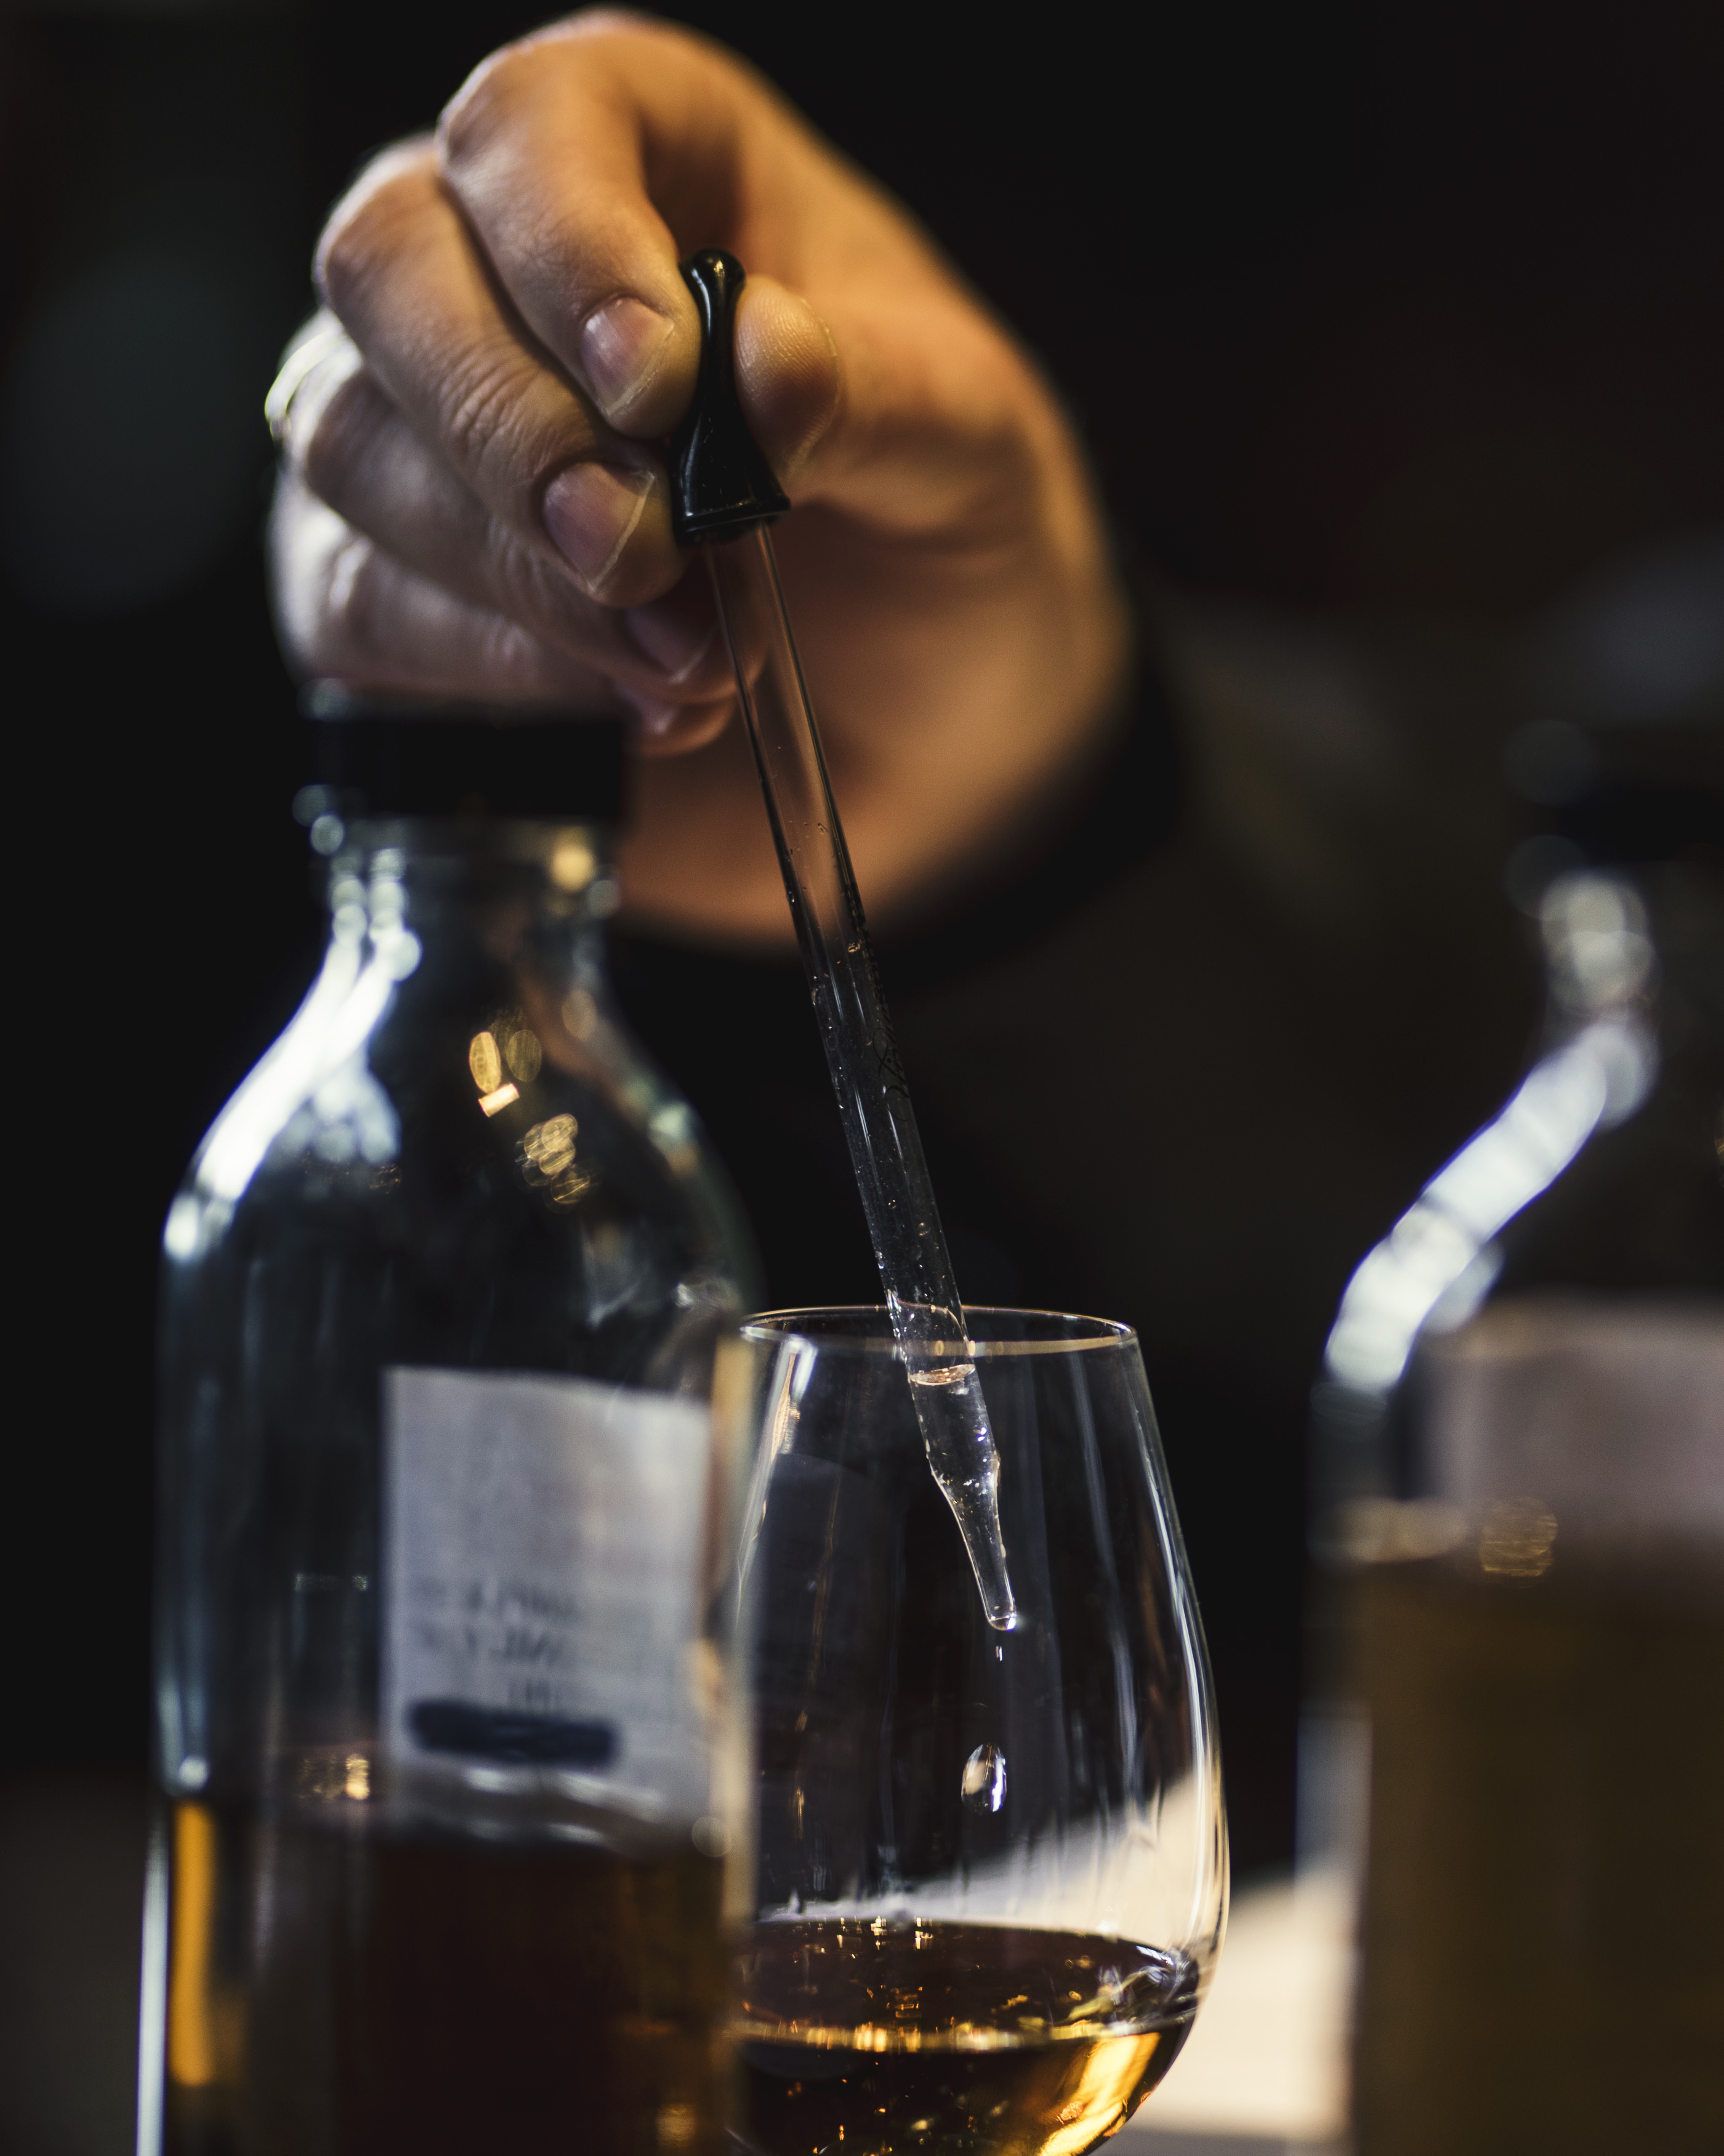
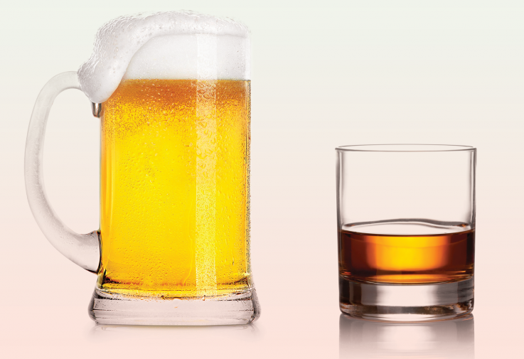
Future work: Could we deploy the model for in vivo data?
Enriching the training data by in vivo data
Transfer learning
Simulated data
In vivo data
In vivo data
=
Simulated data

Slide 19

s.yousefi.radi@lumc.nl
Thank you!

Slide 20
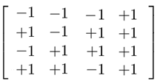
Why Hadamard te-ASL is time efficient?
-
3
2
1
img. 1
-
-
3
2
1
img. 1
-
-
3
2
1
img. 1
-
+
3
2
1
img. 2
+
-
3
2
1
img. 2
+
+
3
2
1
img. 2
+
-
3
2
1
img. 3
-
+
3
2
1
img. 3
-
+
3
2
1
img. 3
-
+
3
2
1
img. 4
+
+
3
2
1
img. 4
+
-
3
2
1
img. 4
+
+ 2
0
0
+ 2
+ 2
0
0
0
0
- 2
- 2
- 2
Label
3 PLD images including 2 averages can be made within 4 acquisitions
Control
If done with multi-delay ASL → 12 acquisitions
Slide from: L. Hirschler & L. Munting et al., Transit time mapping in the mouse brain using time-encoded pCASL, et al., ISMRM 2016

